Slide 1
HSA Investing Made Easy
Investments are not FDIC insured, are not guaranteed by Optum Bank®, and may lose value.
Health savings accounts (HSAs) are individual accounts offered by Optum Bank®, Member FDIC, and are subject to eligibility requirements and restrictions on deposits and withdrawals to avoid IRS penalties. Investments are not FDIC-insured, are not guaranteed and may lose value. State taxes may apply. Fees may reduce earnings on account. The information contained in this presentation is not intended as legal, investment, or tax advice. It is supplied for general educational purposes and with the understanding that Optum does not provide legal, investment, or tax advice. Please contact a competent legal, investment, or tax professional for personal advice on eligibility, investing, tax treatment and restrictions. State taxes may apply. Fees may reduce earnings on account. Federal and state laws and regulations are subject to change.
Notes:
Hi everyone and welcome!
NOTE TO PRESENTER: please adjust investment threshold per the employers requirements.

Slide 2
What we’ll be talking about today
What is an HSA?
Benefits of investing your HSA funds
Eligibility requirements to invest your HSA funds
Getting started
Setting allocations
Setting up transfers
Account management tools
Health Savings Checkup
Q & A
Investments are not FDIC insured, are not guaranteed by Optum Bank®, and may lose value.
Notes:
Today we’re going to review what an HSA is, talk about why investing may be an excellent idea for your HSA savings, the minimum balance needed before you can invest, and how to set up an investment account (including allocations and transfers). We’ll also go over the account management tools available and at the end, and answer any questions you may have.

Slide 3
Quick quiz
1. When am I eligible to invest my HSA dollars in mutual funds?
When my HSA balance meets the minimum investment threshold
There are no eligibility requirements
2. Do I pay taxes on money I earn in an HSA investment account?
Yes, taxes are charged on investment earnings
No, investment earnings are tax free
Investments are not FDIC insured, are not guaranteed by Optum Bank®, and may lose value.
Notes:
First, let’s take a quick quiz, so I can see what you already know.
When am I eligible to invest my HSA dollars in mutual funds?
When my HSA balance meets the minimum investment threshold
There are no eligibility requirements
Do I pay taxes on money I earn in an HSA investment account?
Yes, taxes are charged on investment earnings
No, investment earnings are tax free

Slide 4
What is an HSA?
Health savings accounts (HSAs) are designed to help you save and pay for qualified medical expenses
Deposit money into your HSA.
Save on taxes.
Use your HSA to pay for qualified medical expenses.
Invest your savings in mutual funds.
Investments are not FDIC insured, are not guaranteed by Optum Bank®, and may lose value.
Notes:
Let’s quickly go over what is a health savings account, also known as an HSA?
An HSA an individual deposit account featuring tax-advantaged means to save for health care expenses both now and in the future.
It works like this:
First, you open an account and deposit money into it. This money – including any funds contributed by your employer – is yours to keep, even if you change jobs or health plans.
Next, you save on taxes. The money goes in tax-free, grows tax-free and comes out tax-free – when spent on qualified medical expenses for you, your spouse or your tax dependents.
Finally, once your balance reaches the minimum HSA balance, you can choose to invest a portion of your HSA dollars in mutual funds.

Slide 5
Benefits of investing your HSA funds
No taxes on investment earnings
No taxes on withdrawals for qualified medical expenses
Investments are not FDIC insured, are not guaranteed by Optum Bank®, and may lose value.
Notes:
Today, we’re talking about yet another advantage of an HSA: the ability to invest your HSA dollars in mutual funds to save for the long term and potentially grow your savings.
Once your HSA balance reaches a certain threshold (usually $2,500), you invest some of your HSA cash account in mutual funds. Just like you would do with a 401(k), you choose mutual funds to invest in. But unlike a 401(k), you can easily transfer your investment money back to your HSA at any time, such as if the market changes or you need to pay for a qualified medical expense.
Any investment earnings are tax-free, and you don’t pay taxes on withdrawals for qualified medical expenses. That makes HSA investing one of the smartest investment opportunities around!

Slide 6
Eligibility requirements
HSA BALANCE
MINIMUM
TRANSFER AMOUNT
MINIMUM HSA BALANCE TO
BEGIN INVESTING
$2,500
$100
$2,600
Investments are not FDIC insured, are not guaranteed by Optum Bank®, and may lose value.
Notes:
Before we talk about how you can invest, let’s talk about when you can invest.
You become eligible when your HSA cash account balance meets the minimum required balance, which is typically $2,500.
The minimum amount you can transfer is $100. However, your HSA balance needs to stay at $2,500 or more. This means that the amount you choose to transfer cannot bring your balance below that $2,500 mark.
Let’s look at an example. Say that you have $3,000 in your HSA and want to start an investment account. The most that you can transfer over into investments at this time is $500, bringing your regular HSA down to the investment threshold of $2,500. If you try to transfer more than $500, your account will not allow you to do so. Investments will move at increments of $100. So if you have $2,550 in your HSA, your investment transfer will not occur until your account balance is at least $100 over the investment threshold, or $2,600.
However, after you’ve put some investments in place, it’s okay if your balance drops below $2,500 (such as if you needed to pay for some qualified medical expenses). You just won’t be able to invest any more HSA funds until your balance reaches $2,600 again.

Slide 7
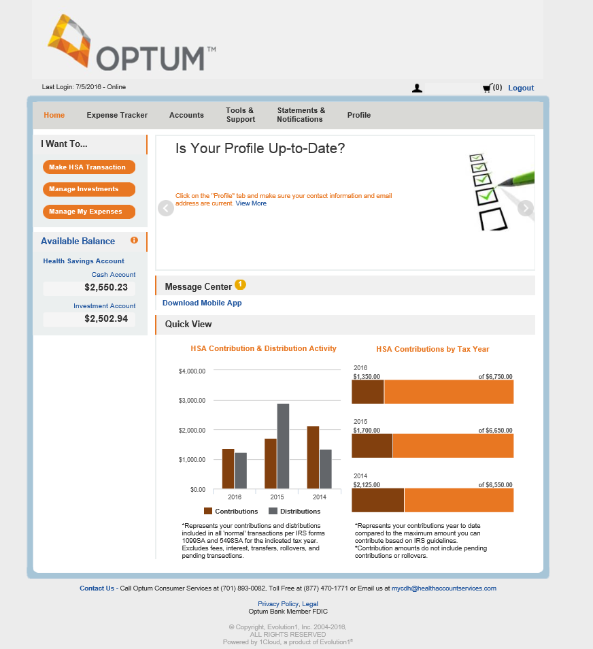
Eligibility requirements
The HSA Dashboard tab on the myCDH.optum.com toolbar shows:
Total HSA cash balance
Investment account balance
Remember:
If your cash account balance exceeds $2,600, you are eligible to invest, if you choose
Investments are not FDIC insured, are not guaranteed by Optum Bank®, and may lose value.
Notes:
To see if you’re eligible, log into your Optum HSA at myCDH.optum.com. You’ll see your current account balance on the left hand side. If your cash account balance exceed $2,600, you are eligible to invest.

Slide 8
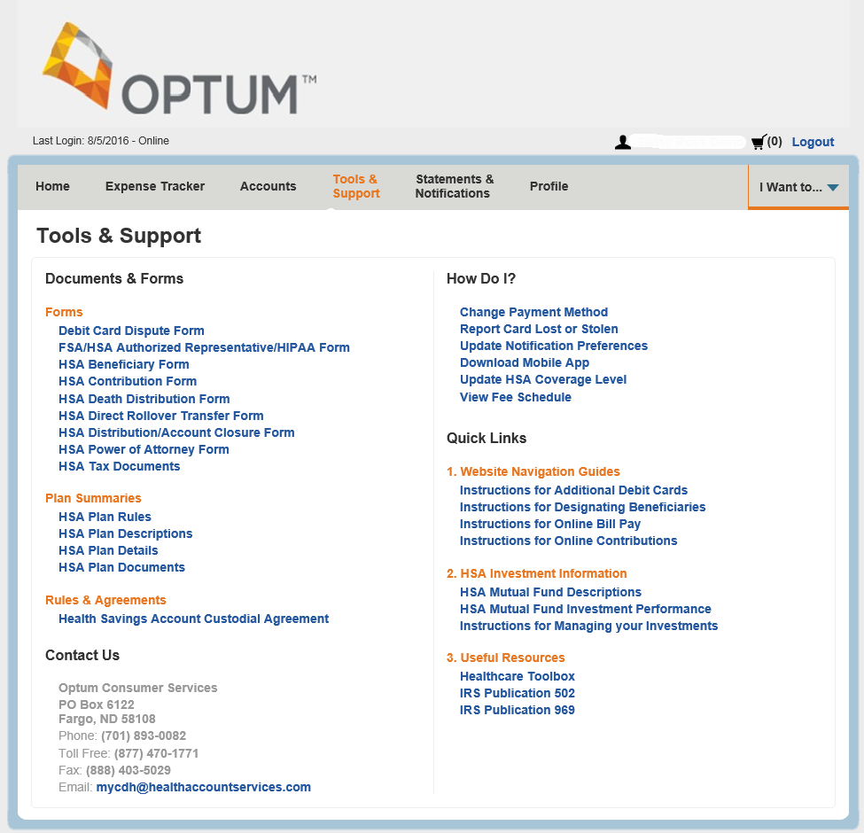
Getting started
Review the education and tools provided at myCDH.optum.com:
Documents and forms
Common questions
Quick links
Customer service
… and more!
Investments are not FDIC insured, are not guaranteed by Optum Bank®, and may lose value.
Notes:
Before you get started, review the education and tools available at myCDH.optum.com to learn more and research common investing questions. There are also many educational resources that may be helpful including various documents and forms, commonly asked questions, quick links and access on how to contact Optum, if needed. Once you access the investing feature of myCDH.optum.com, you’ll have access to additional educational tools specific to investing your HSA. Stay tuned, we will review those later.

Slide 9
Step one: setting allocations
The first step to investing your HSA is setting the allocations for your desired investments based on your personal financial situation, goals and objectives.
Please note: if no allocation is set, 100% of your HSA funds will automatically be invested in the Fidelity Government Money Market fund.
Investments are not FDIC insured, are not guaranteed by Optum Bank®, and may lose value.
Notes:
The first step to investing your HSA is setting the allocations for your desired investments.
Please note: if no allocation is completed, 100% of your funds will automatically be invested in the First American Prime investment account.

Slide 10
Step one: setting allocations
Log in at myCDH.optum.com
Investments are not FDIC insured, are not guaranteed by Optum Bank®, and may lose value.
Notes:
Creating your investment account takes just six easy steps:
First, log in at myCDH.optum.com by selecting “participant log in.”

Slide 11
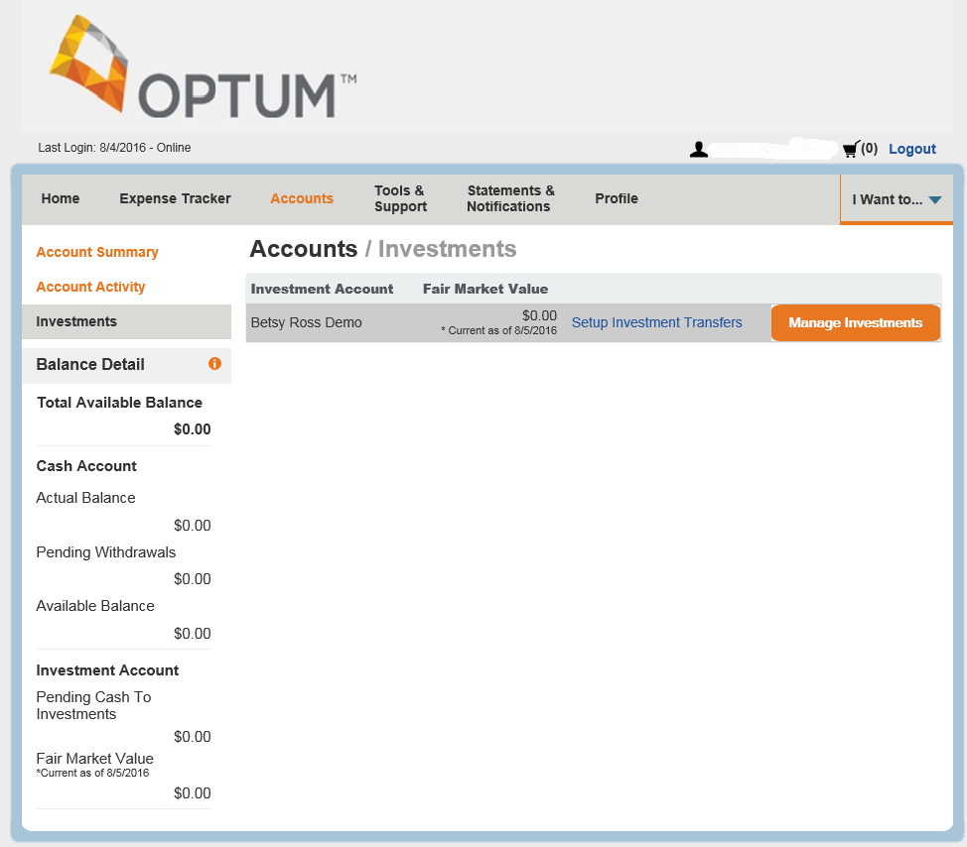
Step one: setting allocations
Navigate to the investment section of your account
Click the “Accounts” tab,
“Investments,” and
“Manage Investments”
Investments are not FDIC insured, are not guaranteed by Optum Bank®, and may lose value.
Notes:
Next, navigate to the investment section of your account. This can be done by selecting the “Account” tab near the top of the page followed by “Investments” on the left hand side, and finally, click the orange “Manage Investments” button.

Slide 12
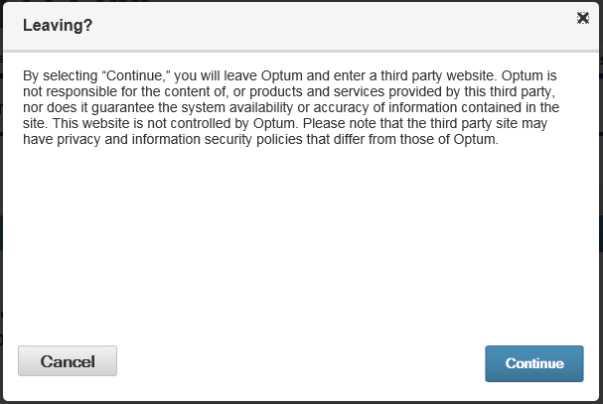
Step one: setting allocations
Click “Continue” to access the third-party website
Investments are not FDIC insured, are not guaranteed by Optum Bank®, and may lose value.
Notes:
This is bring you to a pop-up. Please click “Continue” in order to be navigated to a third-party website to begin the investing process.

Slide 13
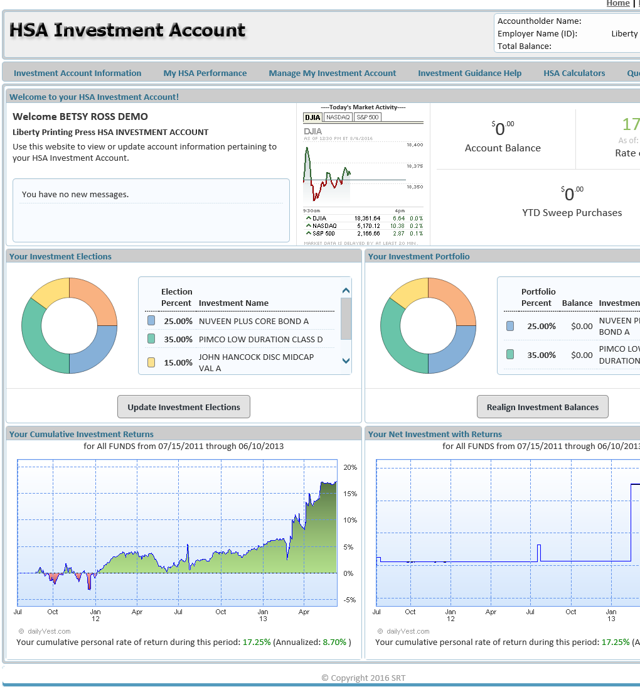
Step one: setting allocations
Select the “Manage My Investment Account” tab
Click “Update Investment Elections”
Investments are not FDIC insured, are not guaranteed by Optum Bank®, and may lose value.
Notes:
Once you have navigated to the third-party website, your screen will be as shown. Select the “Manage My Investment Account” tab near the top, followed by “Update Investment Elections” that appears in the drop down.

Slide 14
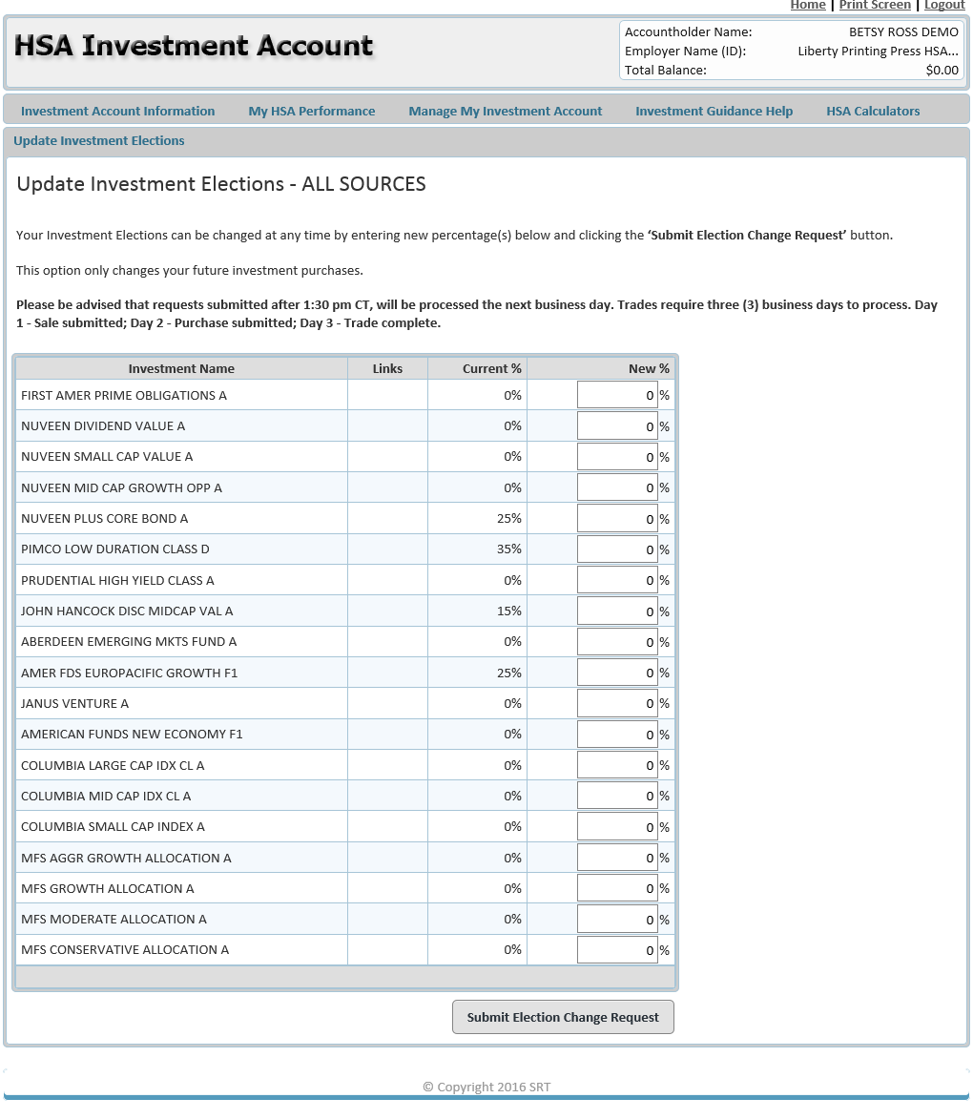
Step one: setting allocations
Designate your desired allocations
Investments are not FDIC insured, are not guaranteed by Optum Bank®, and may lose value.
Notes:
This is where you enter your desired allocation percentages. We will review tools and resources shortly to help with your decision, but please remember that if no allocation is completed, 100% of your funds will automatically be invested in the First American Prime investment account.

Slide 15
Step one: setting allocations
Click “Submit Election Change Request”
Investments are not FDIC insured, are not guaranteed by Optum Bank®, and may lose value.
Notes:
The final step is to select “Submit Election Change Request.” Congratulations! You‘ve completed the first aspect to investing with your HSA.

Slide 16
Step two: setting up transfers
In order for your HSA funds to be invested, you need to complete one final step: setting up your investment transfer threshold and sweeps.
Please note: if no investment transfer threshold is set, your HSA funds will not be transferred to your investment account.
Investments are not FDIC insured, are not guaranteed by Optum Bank®, and may lose value.
Notes:
The next step is to set up fund transfers. In order for your HSA funds to be invested, you need one final step: setting up your investment transfer threshold and sweeps.
Please note: if no investment transfer threshold is set, your HSA funds will not be transferred to your investment account. We will review sweeps and transfers to help make you more familiar.

Slide 17
Transfers and sweeps
What is an investment transfer threshold?
The investment transfer threshold sets the maximum amount of funds to remain in your HSA cash account. All funds exceeding this threshold will be moved automatically from your HSA cash account to your investment account.
The threshold can be increments of $100 within a minimum value of $2,500.
What is a sweep?
A sweep is the process of Optum automatically moving the funds from your HSA cash account to your investment account when the funds in your HSA cash account exceed your investment transfer threshold.
If your account balance falls below the investment transfer threshold, funds will be automatically swept back to your HSA cash account from your investment account.
Investments are not FDIC insured, are not guaranteed by Optum Bank®, and may lose value.
Notes:
You may be asking, what is an investment transfer threshold? What’s a sweep?
The investment transfer threshold sets the maximum amount of funds to remain in your HSA cash account. All funds exceeding this threshold will be moved automatically from your HSA cash account to your investment account. As mentioned, the threshold can be increments of $100 within a minimum value of $2,500.
A sweep is the process of Optum automatically moving the funds from your HSA cash account to your investment account when the funds in your HSA cash account exceed your investment transfer threshold. If your account balance falls below the investment transfer threshold, funds will be automatically swept back to your HSA cash account from your investment account.
For example, if an account holder’s cash account balance is $2,550, this will not trigger a sweep because it does not meet the $100 minimum sweep transaction amount. But, if an account holder’s balance is $2,950, Optum’s system will trigger a sweep transaction that will initiate an investment buy in the amount of $350.

Slide 18
Transfers and sweeps
Example:
Investment transfer threshold is set at $2,800
$2,700
+ $600
$3,300
- $500
$2,800
Account balance as of April 1st
HSA deposit on April 6th
New HSA balance
Automatic transfer/sweep to investment account
New HSA balance
Investments are not FDIC insured, are not guaranteed by Optum Bank®, and may lose value.
Notes:
Let’s go through an example. Say you set your recurring transfer threshold at $2,800. As of April 1st, your HSA balance is $2,700, but you make a deposit on the 6th for $600. This brings your total HSA balance to $3,300. Again, your recurring transfer threshold is set at $2,800. Because of this, $500 will be automatically transferred to your HSA investment account, bringing your HSA balance to $2,800.

Slide 19
Step two: setting up transfers
Select “Setup Investment Transfers”
Investments are not FDIC insured, are not guaranteed by Optum Bank®, and may lose value.
Notes:
First, select “Setup Investment Transfers” on the investment page after you log in at myCDH.optum.com.

Slide 20
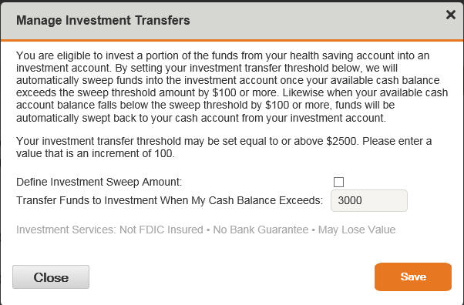
Step two: setting up transfers
Check the checkbox and enter desired investment threshold
Your investment transfer threshold may be $2,500 or more in increments of $100
Investments are not FDIC insured, are not guaranteed by Optum Bank®, and may lose value.
Notes:
The select the checkbox and enter your desired investment threshold.
Your investment transfer threshold may be $2,500 or more, but must be in increments of $100.

Slide 21
Account management tools
Investment homepage
Snapshot view of:
Account messages
Daily market activity
Account balance
Investment elections
Investment portfolio
Investment returns
… and more!
Investments are not FDIC insured, are not guaranteed by Optum Bank®, and may lose value.
Notes:
There are many account management tools available for you online at myCDH.optum.com. Once you navigate to the third-party website, the homepage allows you to view a snapshot of:
Account messages
Daily market activity
Your account balances
Your investment elections, portfolio and returns on investments

Slide 22
Account management tools
Investment Account Information
Current balance by investment
Fund performance & information
Transaction details
Investment account summary
Investments are not FDIC insured, are not guaranteed by Optum Bank®, and may lose value.
Notes:
When you click the “Investment Account Information” tab, you can also find your current balance by investment, fund performance, transaction details and a detailed summary of your account.

Slide 23
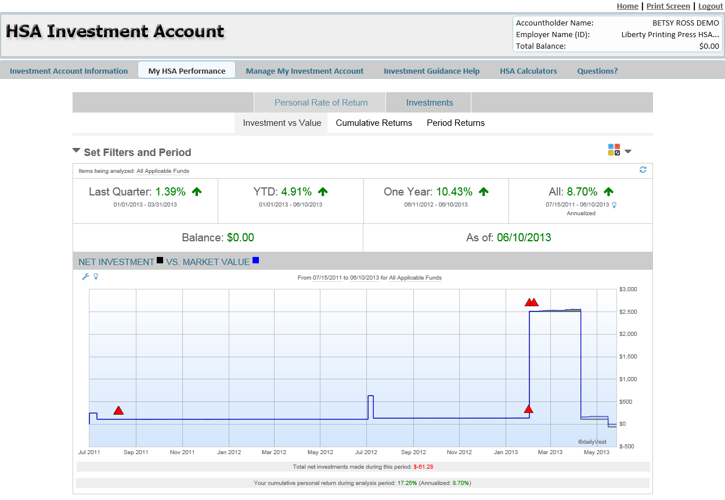
Account management tools
My HSA Performance
Personal rate of return
Investments
Investments are not FDIC insured, are not guaranteed by Optum Bank®, and may lose value.
Notes:
The next tab, “My HSA Performance” shows your personal rate of return and other investment related information specific to your investment elections.

Slide 24
Account management tools
Manage My Investment Account
Update investment elections
Realign investment balances
Transfer between funds
Automatic investment account rebalance
Pending & processed requests
Investments are not FDIC insured, are not guaranteed by Optum Bank®, and may lose value.
Notes:
“Manage My Investment Account” is where we visited earlier to set allocations. Under this tab you can update investment elections or allocations, realign investment balances, transfer between funds, automatically rebalance your investment account and view pending and processed requests.

Slide 25
Account management tools
Investment Guidance Help
Strategy Builder
Education
Investments are not FDIC insured, are not guaranteed by Optum Bank®, and may lose value.
Notes:
The “Investment Guidance Help” tab provides access to Strategy Builder and additional educational tools. Strategy Builder allows you to add details about your health care expenses and/or spouse information in order to develop a personalized HSA savings and investment action plan. The educational tools cover everything from HSA rules, eligibility requirements and qualified medical expenses.

Slide 26
Account management tools
HSA Calculators
Account projection
HSA contribution calculator
HSA goal calculator
HSA savings calculator
HSA vs Traditional Health Plan
Notes:
Finally, the “HSA Calculators” tab give you access to 5 different tools including:
Account projection
HSA contribution calculator
HSA goal calculator
HSA savings calculator
And a calculator to show the differences between an HSA and a Traditional Health Plan
Each of these tools can help you better use and understand your HSA.

Slide 27
Health Savings Checkup
Health care expenses are one of the
#1
financial worries in retirement
Source: https://www.nationwide.com/about-us/120915-nf-healthcare-survey.jsp
Notes:
Before we get to your questions, there is one more important topic we want to mention.
Did you know that health care expenses are one of the top financial worries for retirement? At one time or another, you’ve probably wondered how much money you’ll need. You may have even tried one of those “retirement calculators” you can find online. But what you may have forgotten to take into account is your future health care costs.
Estimating these costs can be done using public averages, but it’s hard to predict your costs, based on your future health needs.

Slide 28
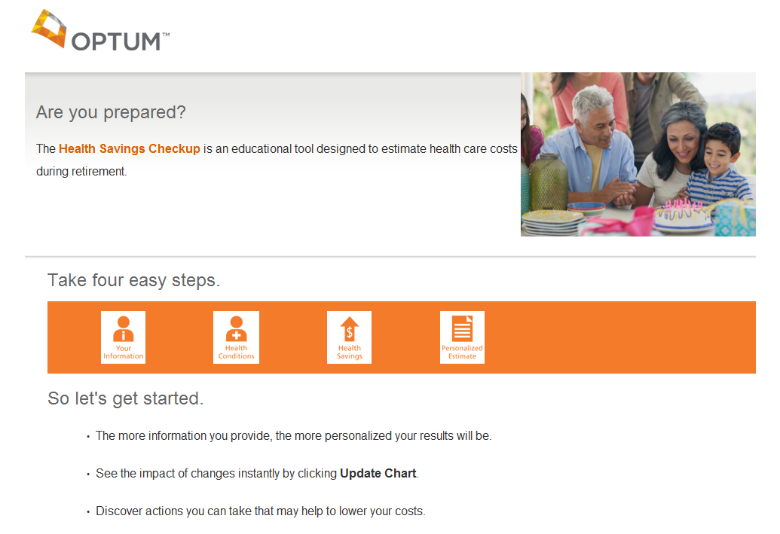
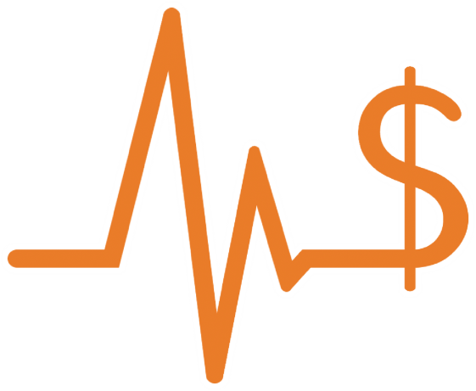
Health Savings Checkup
Wondering if you’ve saved enough money for health care during retirement?
Notes:
A great way to see how specific health conditions could affect your health care costs in retirement is with the Health Savings Checkup tool.
By answering a few questions about your health, your HSA contributions and your retirement goals, you’ll get an estimate of future health care costs. These are then broken down by how much Medicare will cover, how much your HSA will cover, and what you’ll be responsible for.

Slide 29
Health Savings Checkup
Your potential health care costs
Personalized Action Plan
Save for and help lower future health care costs
Notes:
Then, to take it a step further, you can see how potential health conditions could affect your costs as well as how changing your HSA contributions can help you get the most out of your HSA.

Slide 30
Health Savings Checkup
Visit myCDH.optum.com
Click “Health care toolbox”
Scroll to the bottom of the page
Click “Learn more” under Health Savings Checkup
Notes:
You can access the Health Savings Checkup at myCDH.optum.com by selecting the “Health care toolbox” tab and scrolling to the bottom of the page. You’ll see the icon shown here, simply click “learn more.”

Slide 31
Summary
What is an HSA?
A tax-advantaged account that helps you save for healthcare now and in the future
Benefits of investing your HSA
No taxes on earnings or withdrawals for qualified medical expenses
Eligibility requirements to invest your HSA funds
HSA cash balance exceeds $2,500 plus a minimum transfer amount of $100
Getting started
Setting allocations and transfers only takes a few simple steps
Account management tools
Available at myCDH.optum.com
Health Savings Checkup
Helps you better prepare for retirement
Investments are not FDIC insured, are not guaranteed by Optum Bank®, and may lose value.
Notes:
To recap:
What is an HSA? You’re all familiar, but an HSA is a tax-advantaged account that helps you save for healthcare now and in the future.
Why invest? There are no taxes on earnings or withdrawals for qualified medical expenses.
When can you invest? Once your HSA balance reaches the minimum balance of $2,500. Then, there’s a minimum transfer amount of $100. This means you need $2,600 in order to begin investing your HSA in mutual funds.
We went over the six steps for setting allocations and how to set up transfers to move your HSA cash account funds to an investment account automatically.
We checked out the available account management education and tools available at myCDH.optum.com
And finally, we looked at the Health Savings Checkup tool to estimate future health care costs in retirement.

Slide 32
Questions?
Notes:
Now, let’s open things up for questions.

Slide 33
Thank you for attending
For further questions, visit myCDH.optum.com or contact Customer Service at 1‑877‑470‑1771.
Investments are not FDIC insured, are not guaranteed by Optum Bank®, and may lose value.
Health Savings Accounts (HSAs) are individual accounts offered or administered by Optum Bank®, Member FDIC, and are subject to eligibility and restrictions on distributions for qualified medical expenses set forth in section 213(d) of the Internal Revenue Code. State taxes may apply. Fees may reduce earnings on account. This communication is not intended as legal, investment, or tax advice. Please contact a competent legal, investment, or tax professional for personal advice on eligibility, investments, tax treatment, and restrictions. Federal and state laws and regulations are subject to change. Optum Bank is not a broker-dealer or registered investment advisor, and does not provide investment advice or research concerning securities, make recommendations concerning securities or otherwise solicit securities transactions. Orders are accepted to effect transactions in securities only as an accommodation to HSA owner.
Hypothetical example is for illustrative purposes only. All events, persons and results described herein are entirely fictitious and amounts will vary depending on your unique circumstances. Any resemblance to real events or persons, living or dead, is purely coincidental. Current rates are variable and may change at any time.
© 2016 Optum, Inc. All Rights Reserved. 46963B-022016
Notes:
If you think of any questions later, visit myCDH.optum.com.
This site contains lots of easy-to-use information, frequently asked questions, and tools to help you better understand your HSA. Or, you can talk to your benefits representative.
Thank you!

